Slide 1

Using game theory to model healthcare behaviours
Michalis Panayides

Slide 2




EMS – ED Interface
NHS Regulations:
Time Waiting < 4 hours

Slide 3
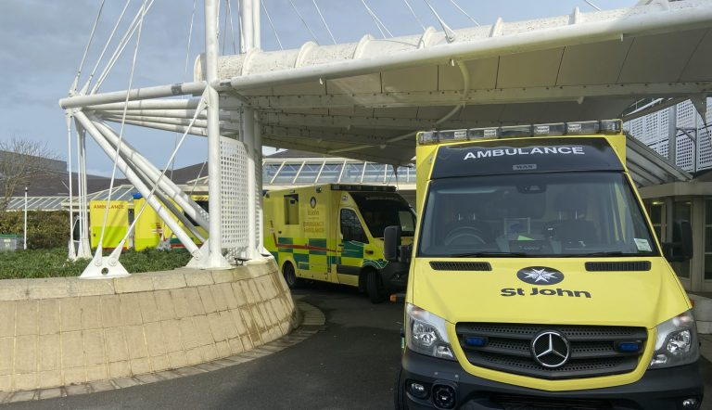
Ambulances outside ED

Slide 4

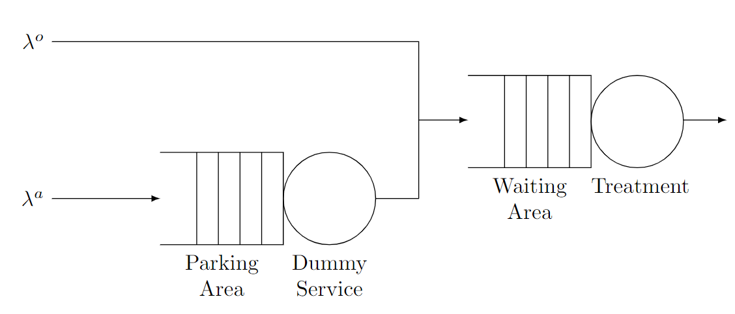
Queueing Model
Blocked Ambulances:
if (number of patients in treatment) > threshold then:
keep individual blocked until otherwise

Slide 5
Gaming Formulation
Strategies of a hospital (Total capacity = 6)
Threshold | 1 | 2 | 3 | 4 | 5 | 6
Hospital A utilities
A_{1,1} | A_{1,2} | A_{1,3} | A_{1,4} | A_{1,5} | A_{1,6}
A_{2,1} | A_{2,2} | A_{2,3} | A_{2,4} | A_{2,5} | A_{2,6}
A_{3,1} | A_{3,2} | A_{3,3} | A_{3,4} | A_{3,5} | A_{3,6}
A_{4,1} | A_{4,2} | A_{4,3} | A_{4,4} | A_{4,5} | A_{4,6}
A_{5,1} | A_{5,2} | A_{5,3} | A_{5,4} | A_{5,5} | A_{5,6}
A_{6,1} | A_{6,2} | A_{6,3} | A_{6,4} | A_{6,5} | A_{6,6}
Hospital B utilities
B_{1,1} | B_{1,2} | B_{1,3} | B_{1,4} | B_{1,5} | B_{1,6}
B_{2,1} | B_{2,2} | B_{2,3} | B_{2,4} | B_{2,5} | B_{2,6}
B_{3,1} | B_{3,2} | B_{3,3} | B_{3,4} | B_{3,5} | B_{3,6}
B_{4,1} | B_{4,2} | B_{4,3} | B_{4,4} | B_{4,5} | B_{4,6}
B_{5,1} | B_{5,2} | B_{5,3} | B_{5,4} | B_{5,5} | B_{5,6}
B_{6,1} | B_{6,2} | B_{6,3} | B_{6,4} | B_{6,5} | B_{6,6}
Ambulance choice (Proportion)
Hospital A | Hospital B
0% | 100%
… | …
100% | 0%
Note: Prop₁ + Prop₂ = 1

Slide 6
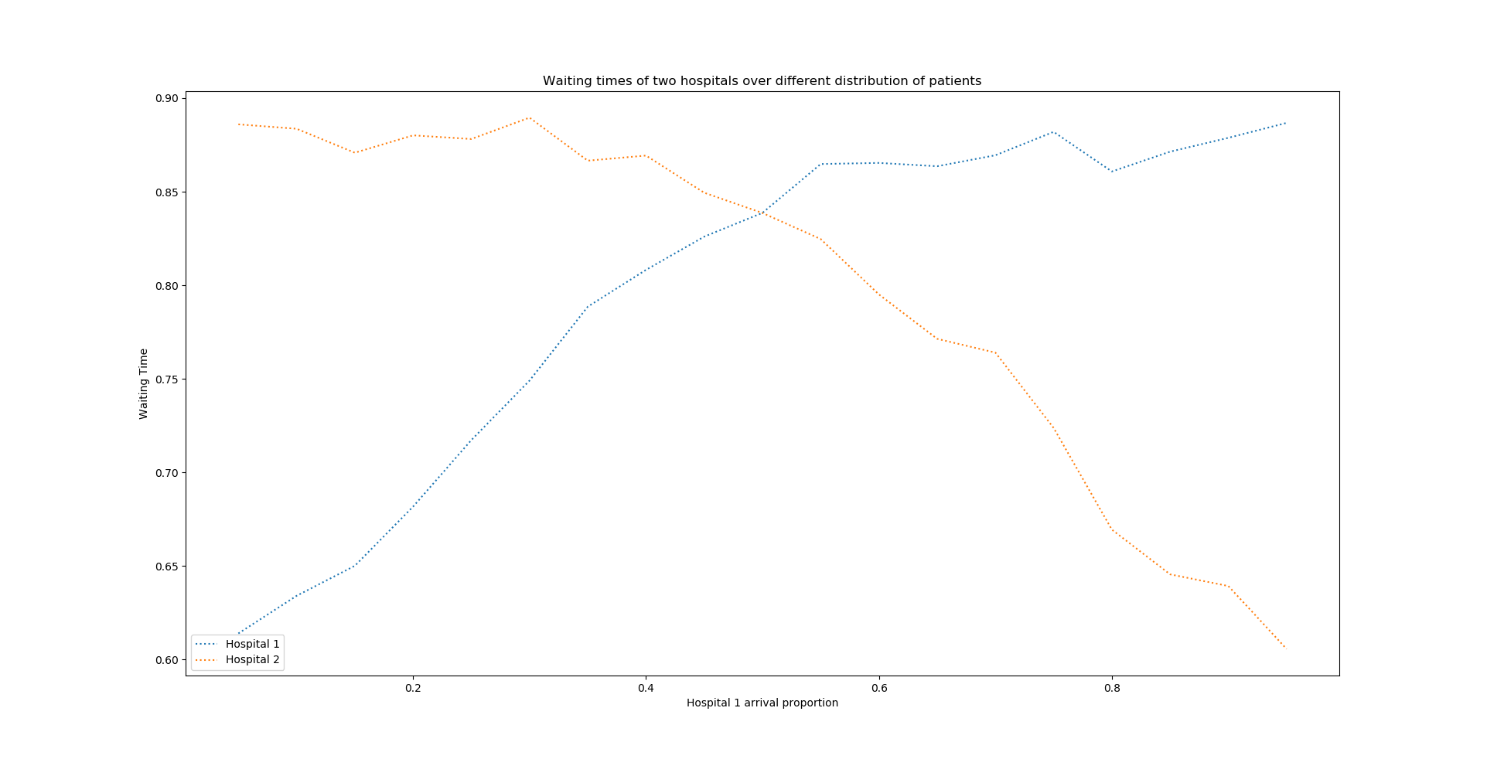
Game between 2 hospitals

Slide 7
THANK YOU Questions?

